Slide 1
Time Series Analysis 1
SYS 4021/6021
Laura Barnes and Julianne Quinn

Slide 2
Organization of lecture
Review of Multiple Linear Regression and Generalized Linear Models
Introduction to Time Series
Common Elements of Time Series
Build Regression Models of Time Series

Slide 3
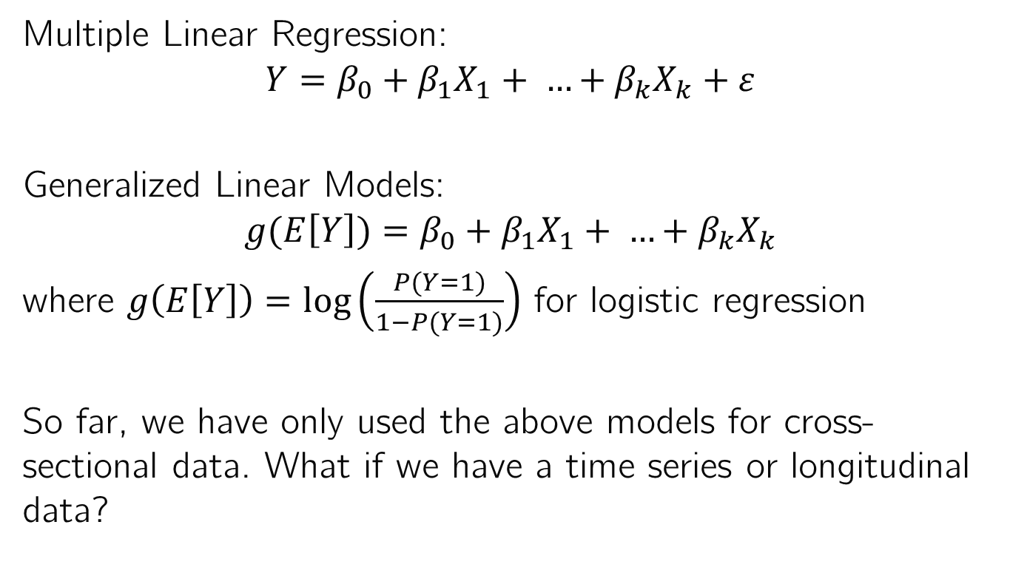
Models Discussed in Class So Far
Multiple Linear Regression:
$$Y=β_{0}+β_{1}X_{1}+ …+β_{k}X_{k}+ε$$
Generalized Linear Models:
$$g(E\left[Y\right])=β_{0}+β_{1}X_{1}+ …+β_{k}X_{k}$$
where $g\left(E\left[Y\right]\right)=log\left(\frac{P(Y=1)}{1−P(Y=1)}\right)$ for logistic regression
So far, we have only used the above models for cross-sectional data. What if we have a time series or longitudinal data?

Slide 4
Time Series Overview
A time series is a sequence of data that have been observed in successive order at different points in time.
It is commonly assumed time series data are spaced equally in time.
Examples:
Company earnings
Global temperature
Air pollution
Stock prices

Slide 5
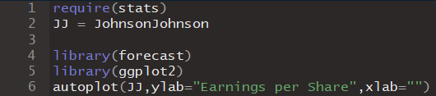
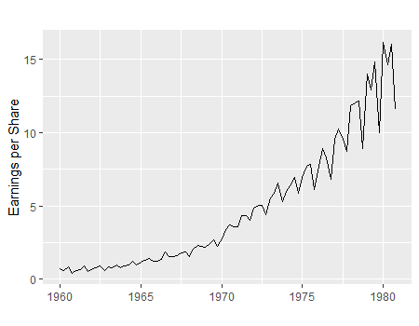
Time Series Example
Johnson & Johnson quarterly earnings per share,
1960-I to 1980-IV:

Slide 6

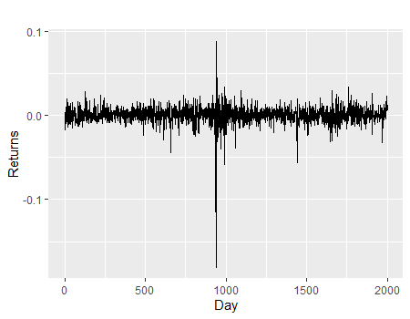
Time Series Example
Returns of the NYSE. Daily value-weighted market returns of 2000 trading days, Feb 2, 1984 – Dec 31, 1991:

Slide 7
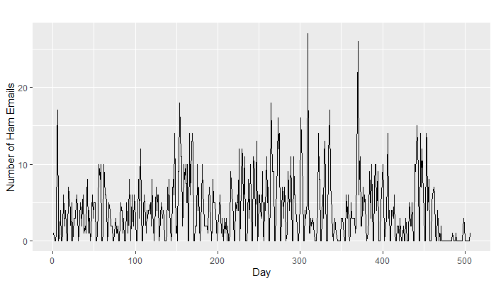
Time Series Example
Ham emails received per day, January 2000 – June 2001:

Slide 8
Time Series Analysis
If we want to predict the value of some variable Y at time t, Y_{t}, can we use MLR or GLM?
These methods both assume adjacent observations are independent and identically distributed (iid).
This is often violated with time series data. If we don’t account for that, we might get biased estimates or underestimate variability.
In time series analysis we’ll need to account for this “auto-correlation” (correlation of a variable with itself).

Slide 9
Time Series Analysis
Autocorrelation is one common element of time series data we’ll need to account for in applying MLR or GLM to make forecasts.
What other common elements might time series include? Let’s consider an example.

Slide 10
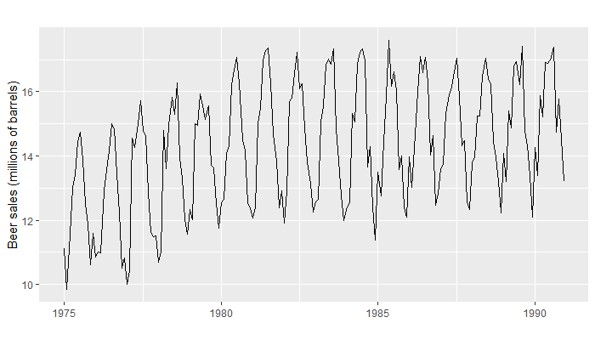
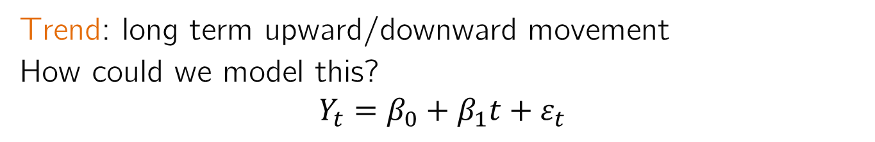
Time Series Components
Trend: long term upward/downward movement
How could we model this?
$$Y_{t}=β_{0}+β_{1}t+ε_{t}$$

Slide 11
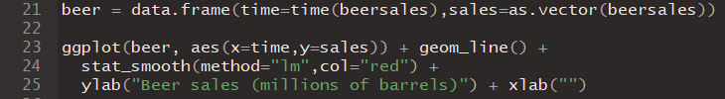
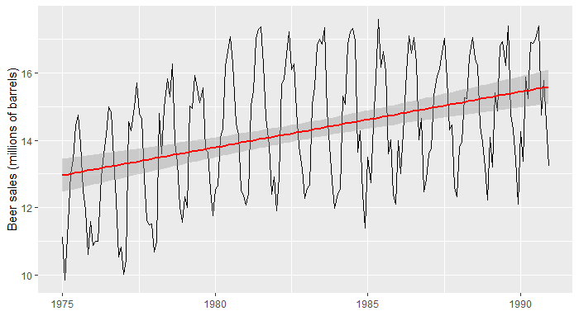
Trend
Might there be a better way to model this trend?

Slide 12
Trend
$Y_{t}=β_{0}+β_{1}t+{β_{2}X}_{1}+β_{3}X_{1}t+ε_{t}$ where $X_{1}=1 if t>1982, 0 otherwise$
Could try different cutoffs and see what results in the best model

Slide 13
Trend
What else do we need to model in this dataset?

Slide 14
Cycles and seasons
Cycles and seasons are recurring long-term up and down movements
Cycles can have a duration of any length of time. They are measured from peak to peak, or trough to trough
Seasons are periodic patterns that complete themselves within a specified time period and are then repeated in the same amount of time.

Slide 15
Example cycles vs. seasons
Cycles
Seasons
Business cycle: Recurrent periods of prosperity (expansion) alternating with recession (contraction). Expansion ends at the peak and contraction ends at the trough.
Climate cycles: e.g. El Nino-Southern Oscillations
Weather measurements (e.g. daily temperature repeats over a year)
Sales in a department store (repeats over a year)
Tides (high tides repeat twice per day; spring tides repeat twice per month)

Slide 16
Modeling seasonality
We model trends by including time as a predictor. How can we model seasonality?
There are a couple ways. One is through dummy variables.
For L seasons, we can use L-1 dummy variables to adjust the mean in each season relative to the base case season.

Slide 17
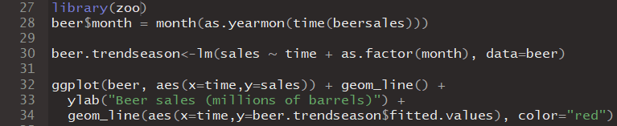
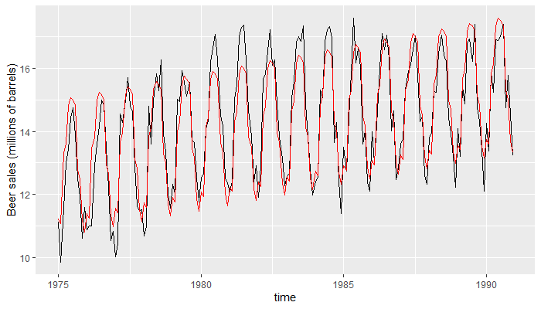
Seasonality

Slide 18
Modeling seasonality
For monthly data exhibiting an annual season, we need 11 dummy variables.
What if we had daily data? Is it reasonable to use 364 dummy variables? We would need significantly > 364 observations to do that.
For smoothly varying seasons that require more dummy variables than we have enough data to estimate, we can instead use trigonometric functions, e.g. sin(2πt/T) and cos(2πt/T) where T = # of time steps in a season.

Slide 19
Modeling seasonality
Dummy variables allow for easier interpretation and testing.
Trigonometric models have better parsimony. Using trigonometric terms usually requires less parameters, but requires smoothly varying seasons.

Slide 20
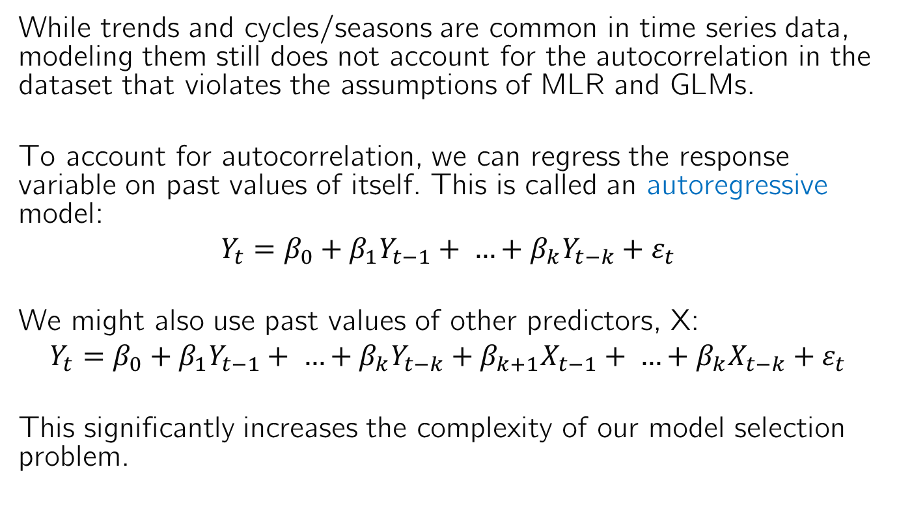
Autocorrelation
While trends and cycles/seasons are common in time series data, modeling them still does not account for the autocorrelation in the dataset that violates the assumptions of MLR and GLMs.
To account for autocorrelation, we can regress the response variable on past values of itself. This is called an autoregressive model:
$$Y_{t}=β_{0}+β_{1}Y_{t−1}+ …+{β_{k}Y}_{t−k}+ε_{t}$$
We might also use past values of other predictors, X:
$$Y_{t}=β_{0}+β_{1}Y_{t−1}+ …+{β_{k}Y}_{t−k}+β_{k+1}X_{t−1}+ …+{β_{k}X}_{t−k}+ε_{t}$$
This significantly increases the complexity of our model selection problem.

Slide 21
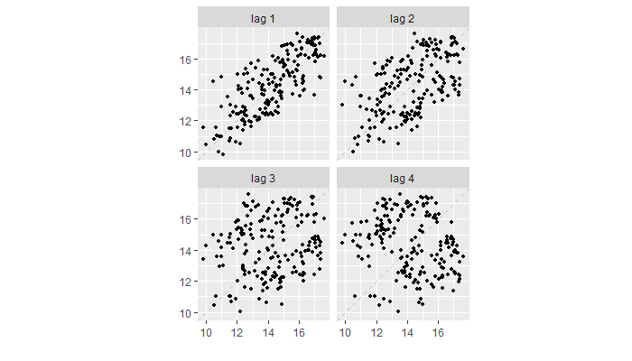
Lag Plots of Beer Sales

Slide 22
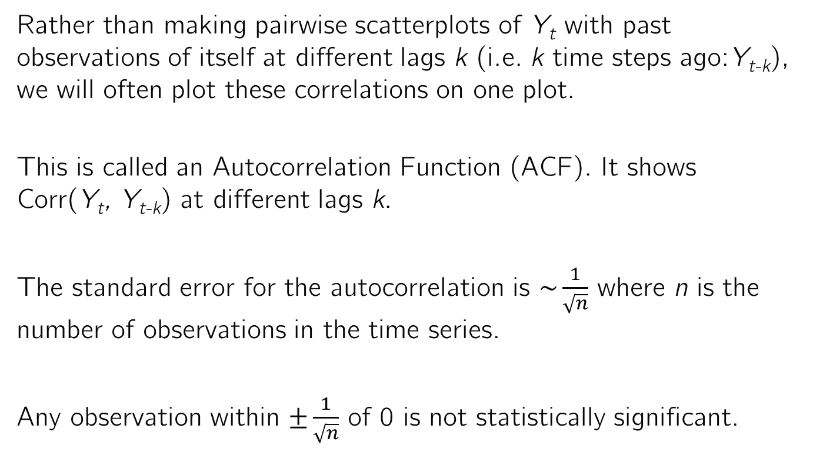
Autocorrelation
Rather than making pairwise scatterplots of Y_{t} with past observations of itself at different lags k (i.e. k time steps ago:Y_{t-k}), we will often plot these correlations on one plot.
This is called an Autocorrelation Function (ACF). It shows Corr(Y_{t}, Y_{t-k}) at different lags k.
The standard error for the autocorrelation is $\sim \frac{1}{\sqrt{n}}$ where n is the number of observations in the time series.
Any observation within $±\frac{1}{\sqrt{n}}$ of 0 is not statistically significant.

Slide 23
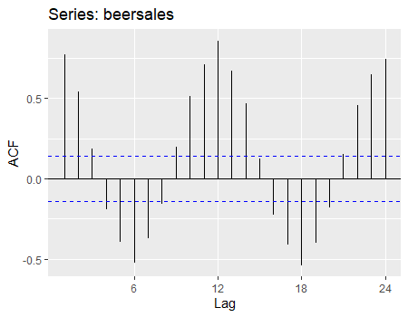
Beer Sales ACF

Slide 24
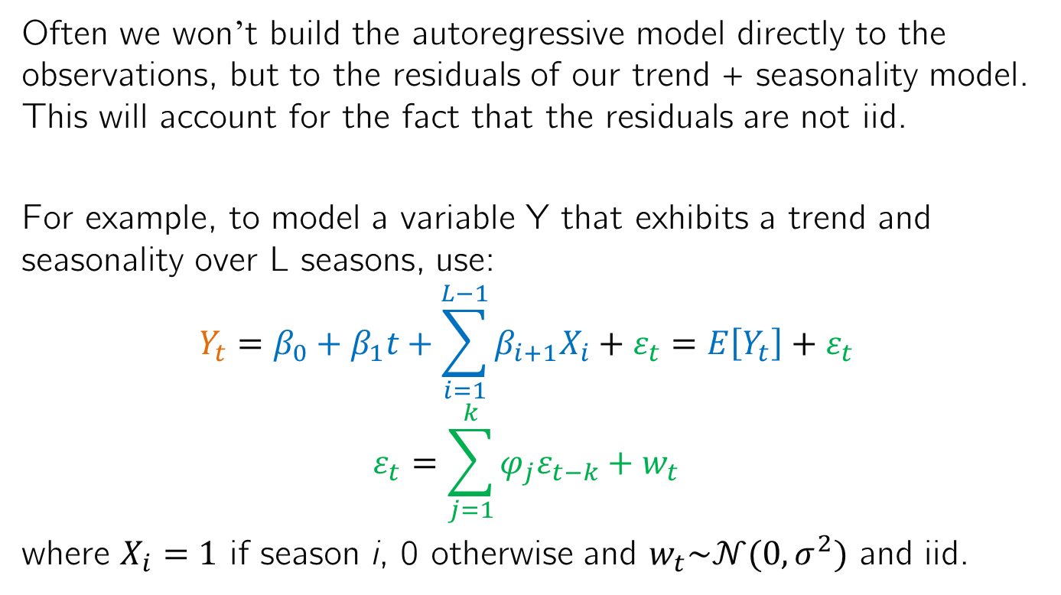
Regression for Time Series Analysis
Often we won’t build the autoregressive model directly to the observations, but to the residuals of our trend + seasonality model. This will account for the fact that the residuals are not iid.
For example, to model a variable Y that exhibits a trend and seasonality over L seasons, use:
$$Y_{t}=β_{0}+β_{1}t+\sum_{i=1}^{L−1}{β_{i+1}X_{i}}+ε_{t}=E\left[Y_{t}\right]+ε_{t}$$
$$ε_{t}=\sum_{j=1}^{k}{{φ_{j}ε}_{t−k}+w_{t}}$$
where $X_{i}=1$ if season i, 0 otherwise and $w_{t}\sim 𝒩(0,σ^{2})$ and iid.

Slide 25
Summary
Time series can be modeled with MLR and GLMs, but we have to account for autocorrelation to meet the iid assumptions of these methods.
There are many other common elements of time series that may need to be modeled:
Trends: use t as a predictor
Seasonality/cycles: use dummy variables or trigonometric functions
Auto-correlation: consider past observations/past residuals as predictors

